Slide 1
UNIVERSITY OF SÃO PAULO
Whispers of the Universe: theoretical and observational developments in the BINGO/ABDUS project.
I present the theoretical developments expected in the construction of the BINGO (BAO from Integrated Gas Observations) observatory, which is being supported by a consortium led by Brazil and China, including UK, South Africa, France and Italy.
Elcio Abdalla
2023

Slide 2
Team
Management: Elcio Abdalla, A. Queiroz, Bin Wang, C. A. Wuensche, F. Abdalla, L. Barosi, T. Villela
Builders: JiaJun Zhang, Chang Feng, Ricardo Landim, Alessandro Marins, Camila Novaes
Members (USP): Jordany Vieira de Melo, Pablo Motta, Gabriel Hoerning, Lucas Formigari, Eveling Costa, Carlos Ottobone + Nicoli, Joara, Alex Sander, Luiza, Thiago, Raphael.

Slide 3
Open Problems
What is Dark Energy
What is Dark Matter
Gravity in Cosmology
Fast Radio Bursts
Pulsars

Slide 4
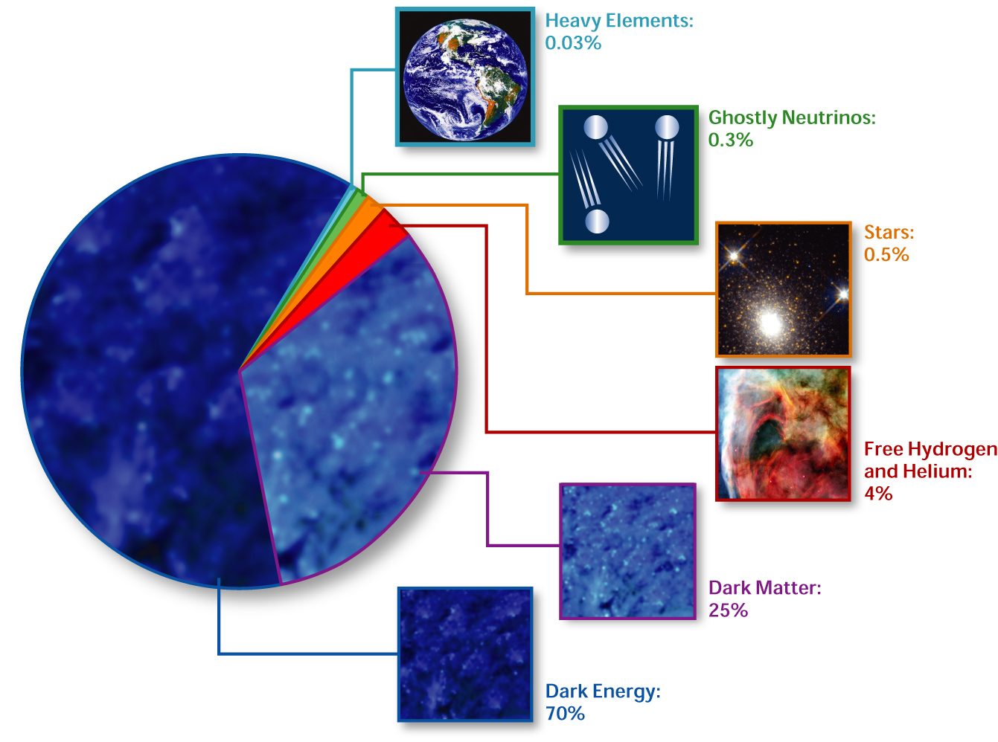
Standard Cosmological Model Composition of the Universe
Elcio Abdalla-Interacting Dark Energy
http://en.wikipedia.org/wiki/Image:Cosmological_composition.jpg source and rights]

Slide 5
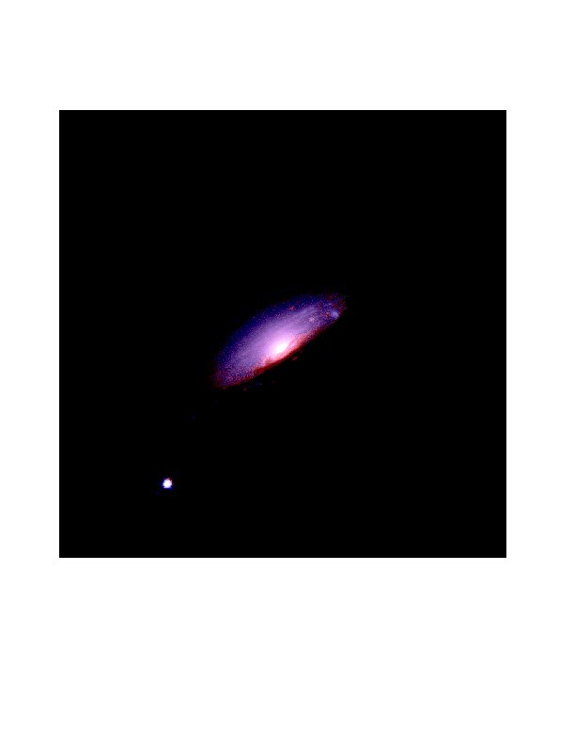
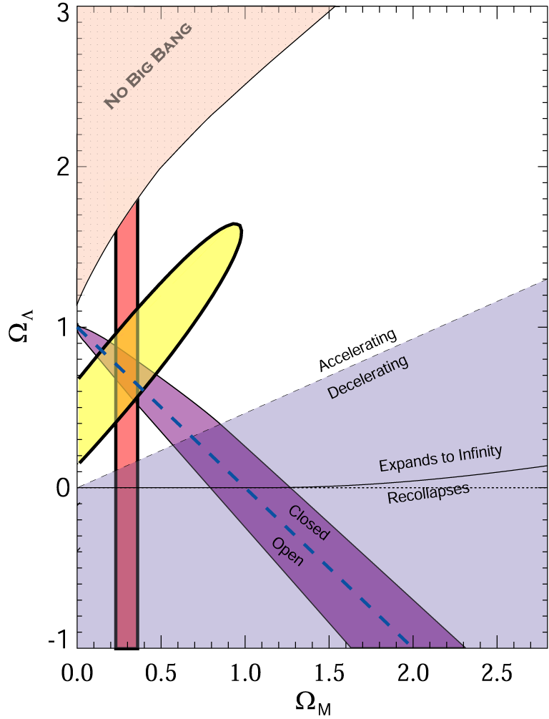
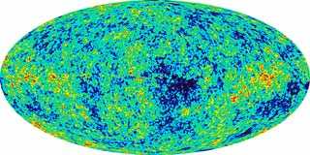
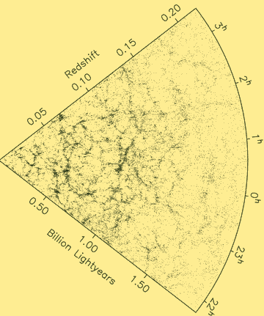
What is Dark Energy?
The Evidence:
98's: The universe is expanding in an accelerated way.
CMB
SNe Ia
Ω_{DE}=0.721±0.025 (WMAP)
WMAP
LSS
Ω_{DE}=0.685±0.013 (Planck)
Source: S. Tsujikawa, “Dark Energy and Modified Gravity"

Slide 6
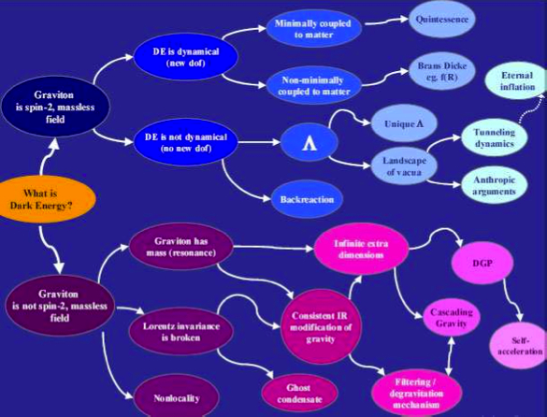
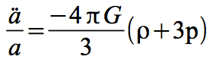
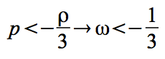
What is causing the acceleration?
Source: de Rahm & Tolley, 2008

Slide 7
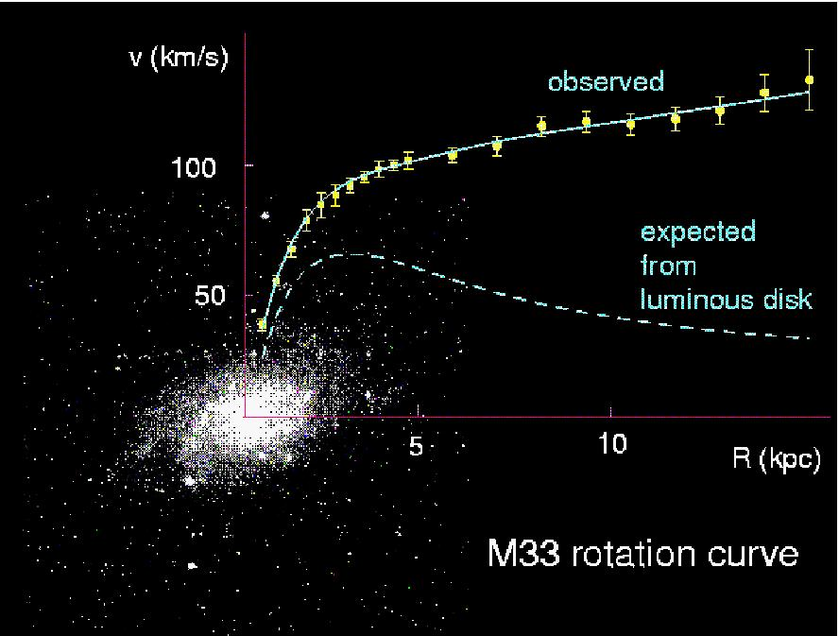
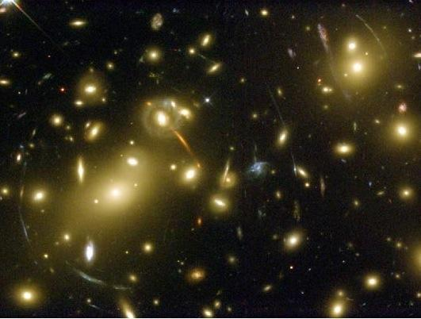
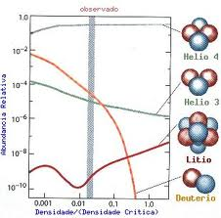
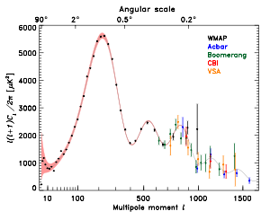
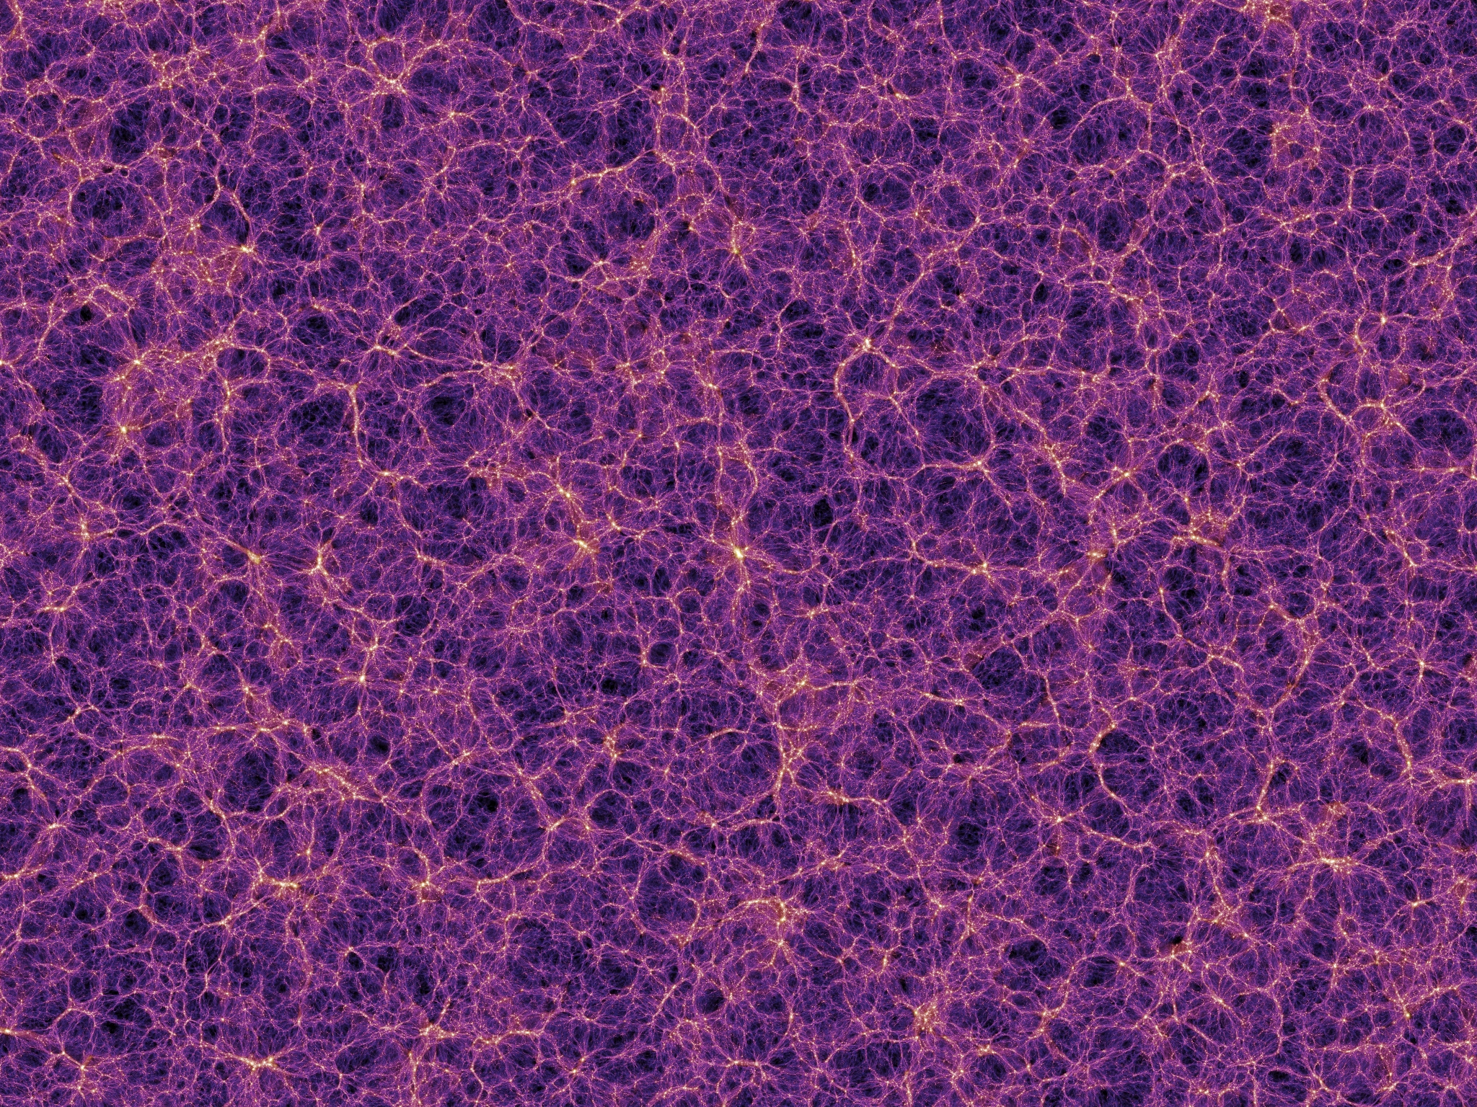
What is Dark Matter?
Evidences for Dark Matter
Huge amount of evidences
indicating that dark matter
exists. One of the biggest
unsolved, but very well measured,
problems in physics.
Observations indicate that DM
interacts mainly gravitationally.
So far, we have no
(non-contradictory) observations
that DM was detected by any
non-gravitational mechanism.
Elcio Abdalla-Interacting Dark Energy

Slide 8
Candidates
Neutralinos (higgsino, bins, winos, singlinos)
Axinos
Gravitinos
Sneutrinos
Axions
Sterile neutrinos
4th generation neutrinos
Kaluza-Klein photons
Kaluza-Klein gravitons
Brane world dark matter/D-matter
Little higgs dark matter
Light scalars
Superheavy states (ie. “WIMPzillas”)
Self-interacting dark matter
Super-WIMPs
Asymmetric dark matter
Q-balls (and other topological states)
CHAMPs (charged massive particles)
Cryptons, …
Supersymetric

Slide 9
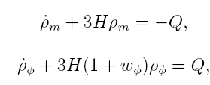
DE/DM Interaction
Each component is not conserved alone anymore.
Cosmological equations:
Many many models in the literature:
Phenomenological (For a classiﬁcation see Koyama, Maartens, Song, 0907.2126; see also Wang, Abdalla, Atrio Barandela, Pavon Rep. Prog. Phys. 2016)
- Interaction depending on DM or DE
Constant coupling
or
Time varying coupling
Coupling must be small : constraints from observations!
In general no analytic solution!

Slide 10
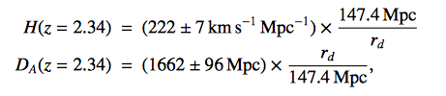
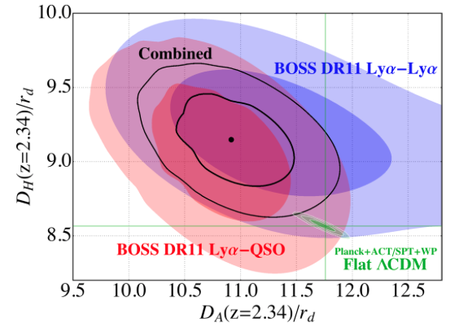
Evidence Against ΛDCM?
Baryon Acoustic Oscillations in the Lyα forest of BOSS DR11 quasars.
T. Delubac et al. [BOSS Collaboration] – A&A 574, A59 (2015), arXiv: 1404.1801
From adjusting the BAO peaks and combining with the ΛCDM fiducial values from Planck+ WMAP:
Values differ: 1.8σ from Planck+WP;
1.6σ from WMAP9+ACT+SPT
Constraints on (D_{A}/r_{d},D_{H}(=H/c)/r_{d})
Conclusion: Approximately 2σ below the value of D_{H}
And 2σ above the value of D_{A}
compared to the ΛCDM prediction.

Slide 11
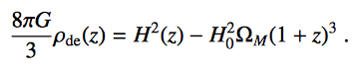
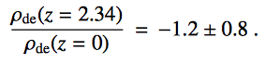
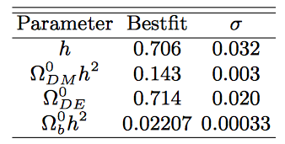
Evidence Against ΛDCM?
Baryon Acoustic Oscillations in the Lyα forest of BOSS DR11 quasars.
T. Delubac et al. [BOSS Collaboration] – A&A 574, A59 (2015), arXiv: 1404.1801
-
~2.5σ difference from the expected from ΛDCM!
Parameters from Planck+WMAP for ΛDCM
Interacting dark energy
Review Rep. Progr. Phys.: Wang, E.A., Atrio-Barandela, Pavon

Slide 12
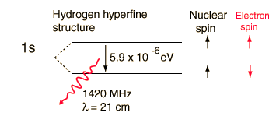
21 cm Physics – The Hyperfine Structure

Slide 13
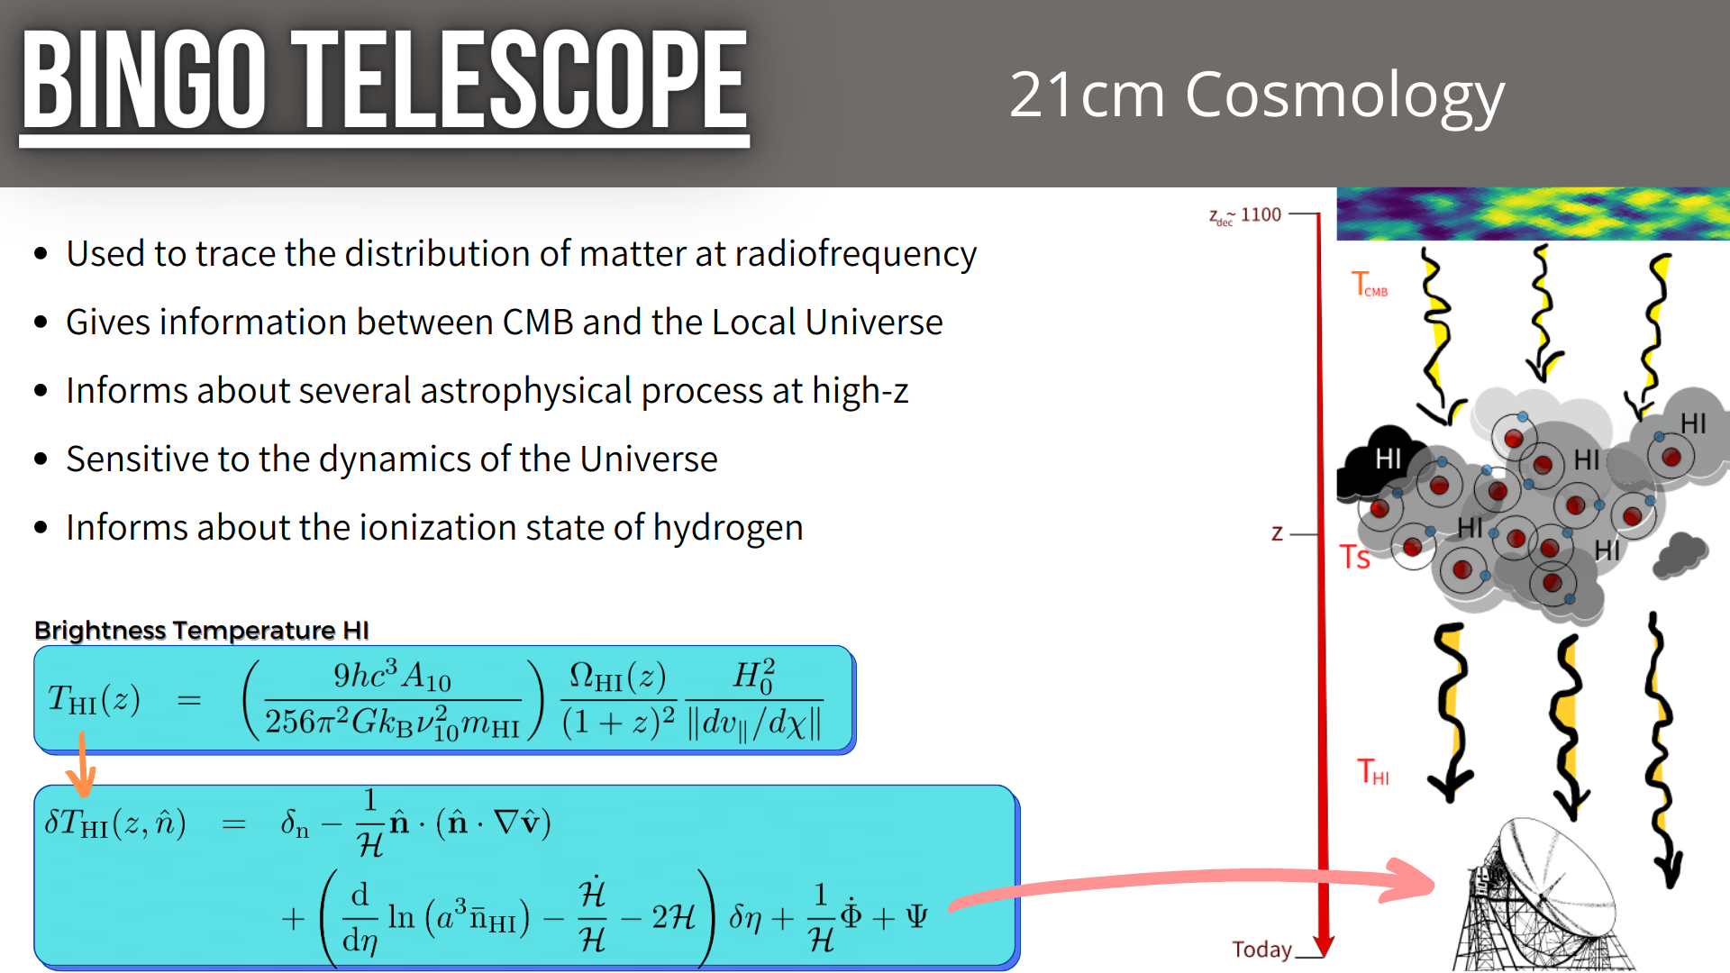
21 cm Cosmology: Motivation and Methods

Slide 14
Intensity Mapping
No Search for particular emission
Search instead for general Hydrogen emission
Large clouds

Slide 15
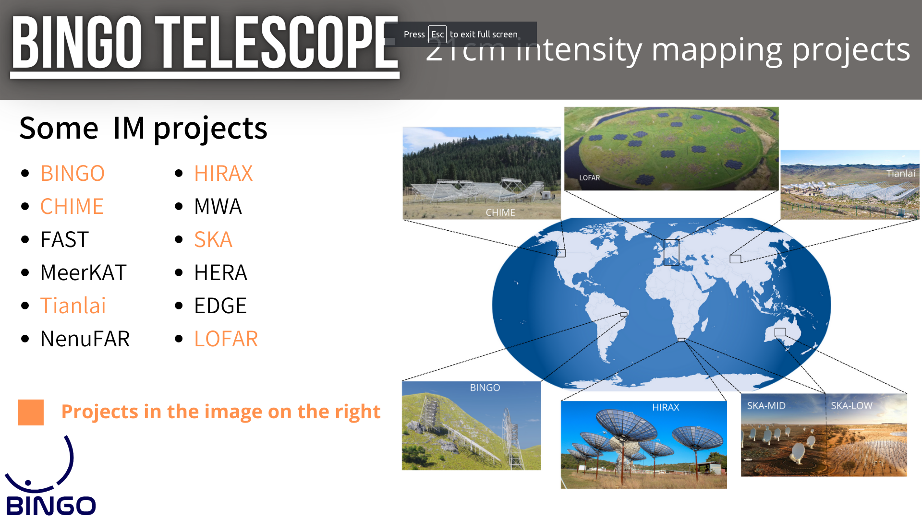

Slide 16
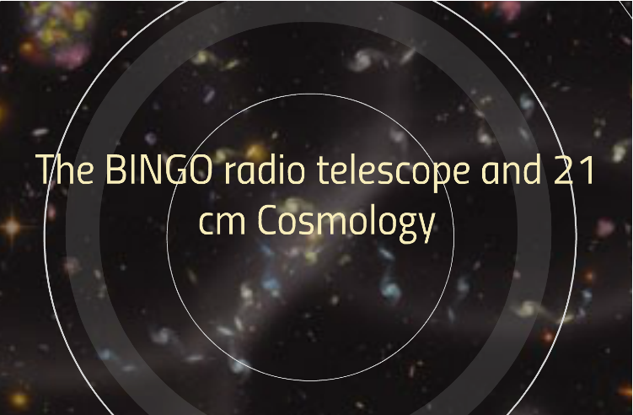

Slide 17
Bingo´s aims
BAO for Integrated Neutral Gas Observations
Large scale structure and constraints on Cosmological parameters (particularly DE)
HI intensity map at 0.127 < z < 0.448
Astrophysical phenomena: Fast Radio Bursts and Pulsars

Slide 18
What is Bingo?
BAO for Integrated Neutral Gas Observations
A single/double dish multiple Horns Radio Telescope, mainly to measure BAO
Short scale phenomena (we can pinpoint short lumps)

Slide 19
The Instrument
Two dishes (40 and 39 meters)
28 Horns (1.8 m wide, 4.8 m long)
System Temperature 50 K (up to now, we have 70K)
Simple off the shelf electronics in phase 1
Phased arrays in ABDUS (Advanced Bingo Dark Energy Studies
Site at “Serra do Urubu” (Vulture heights) in Paraíba, Brazil

Slide 20
The Site

Slide 21
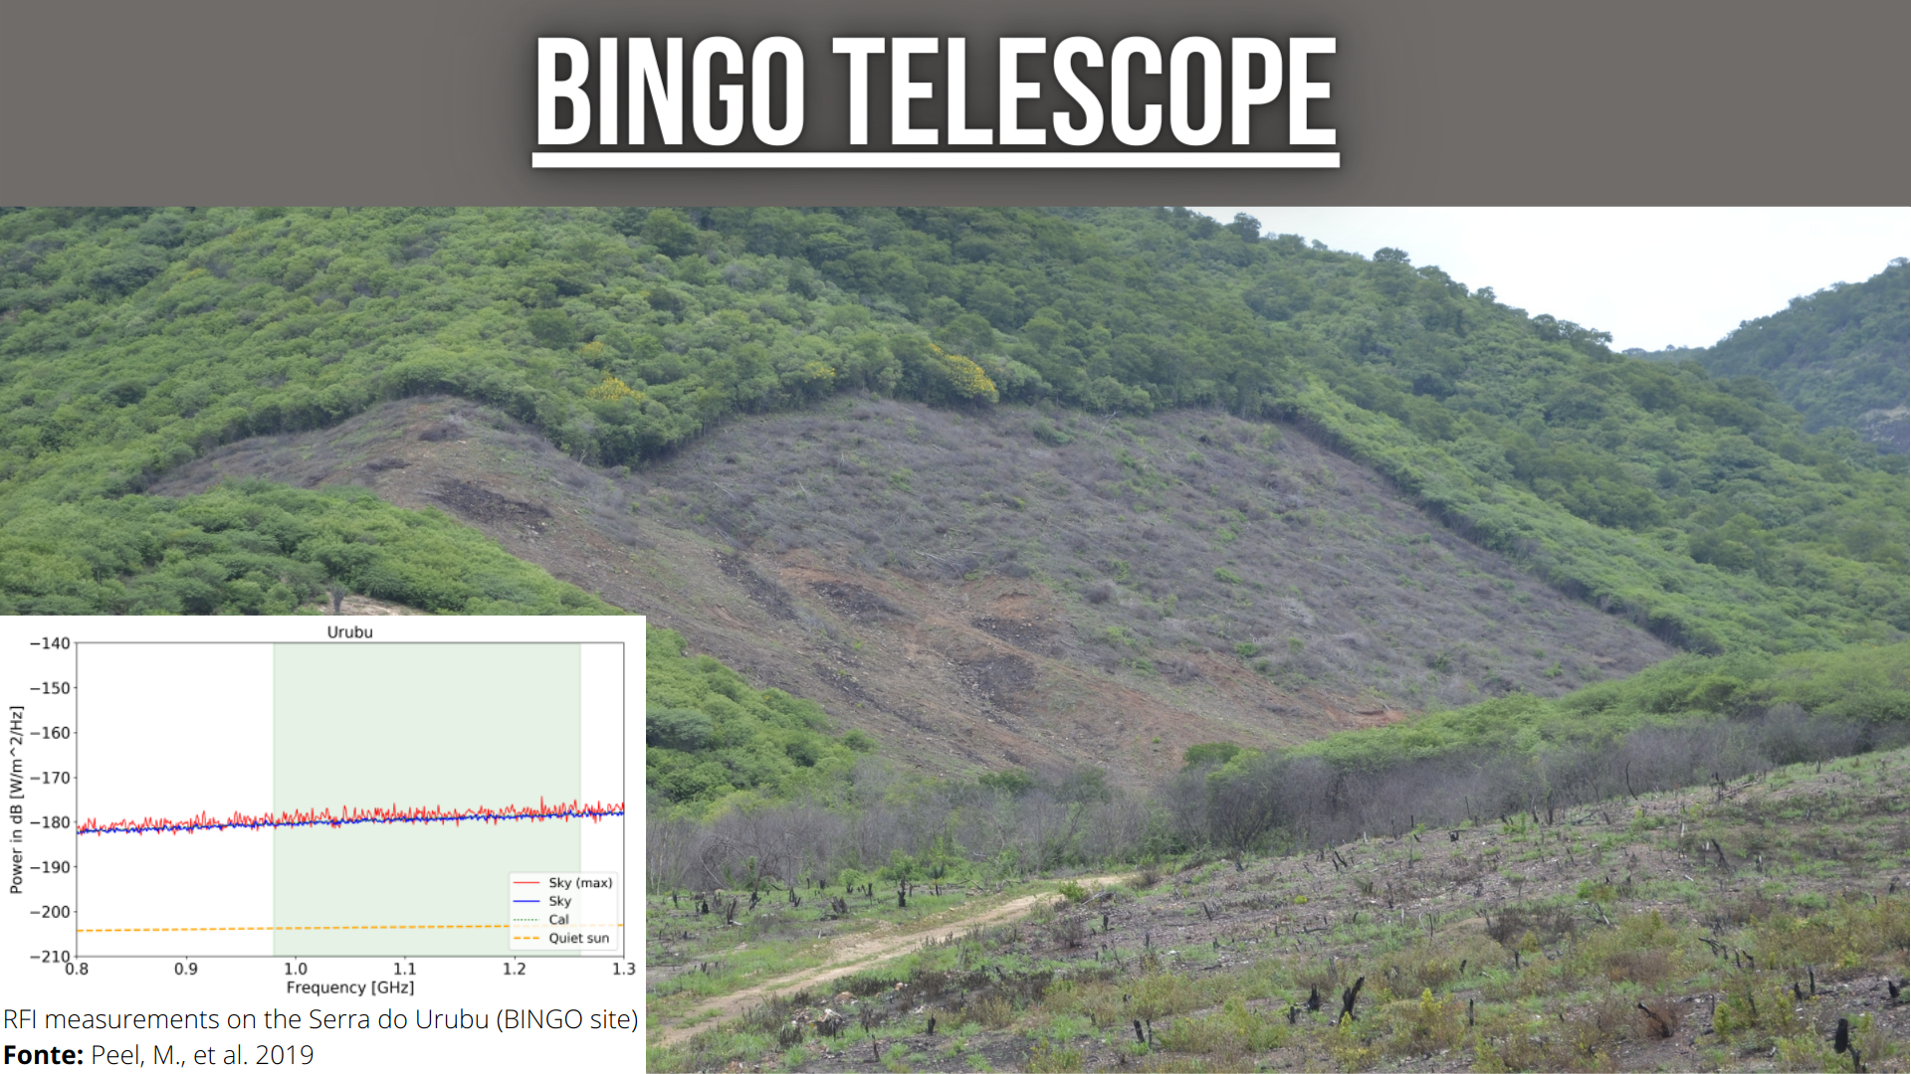
The Site
Clean sites in South America

Slide 22
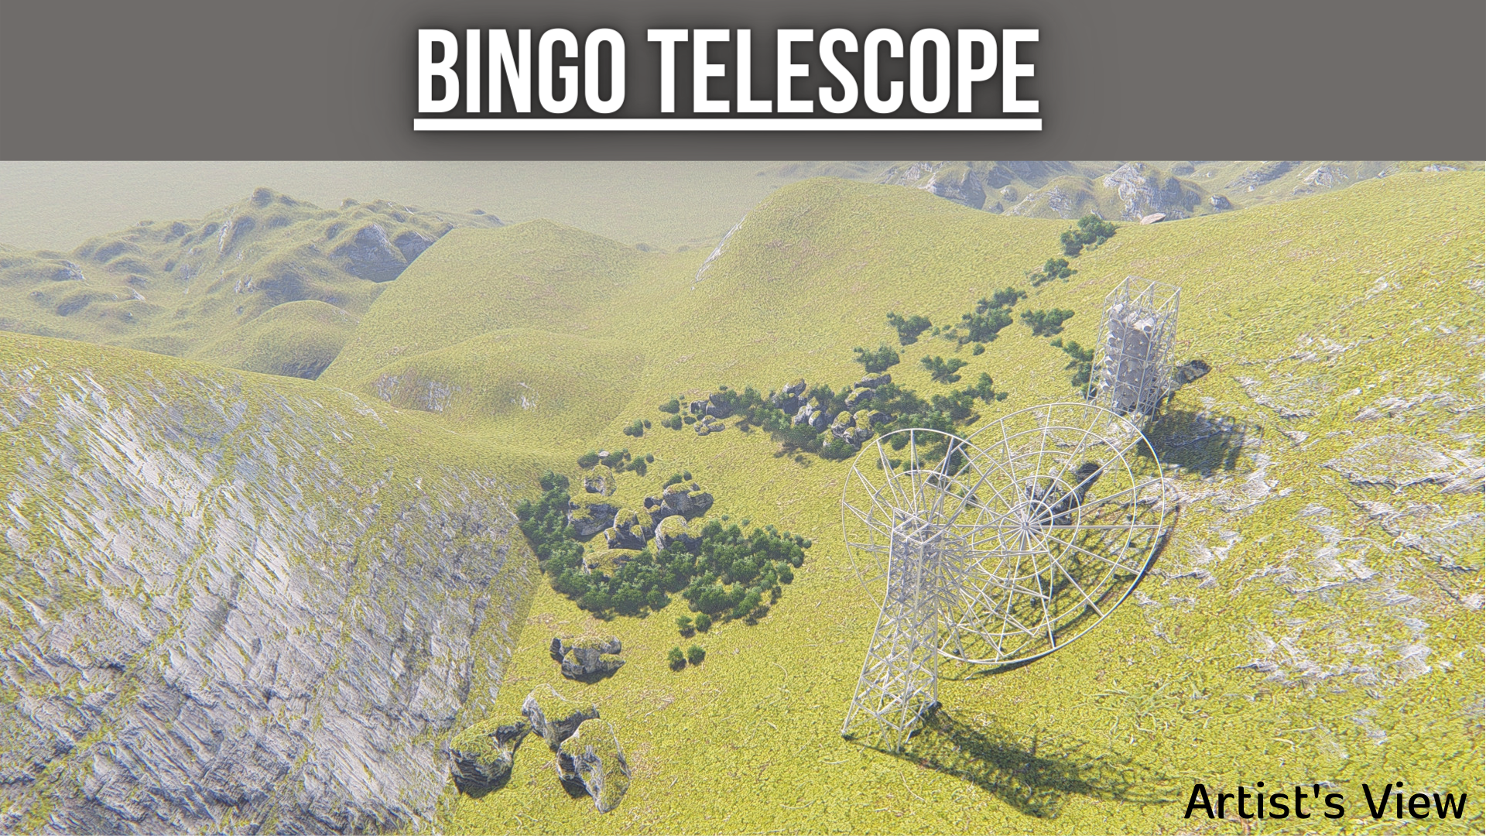

Slide 23
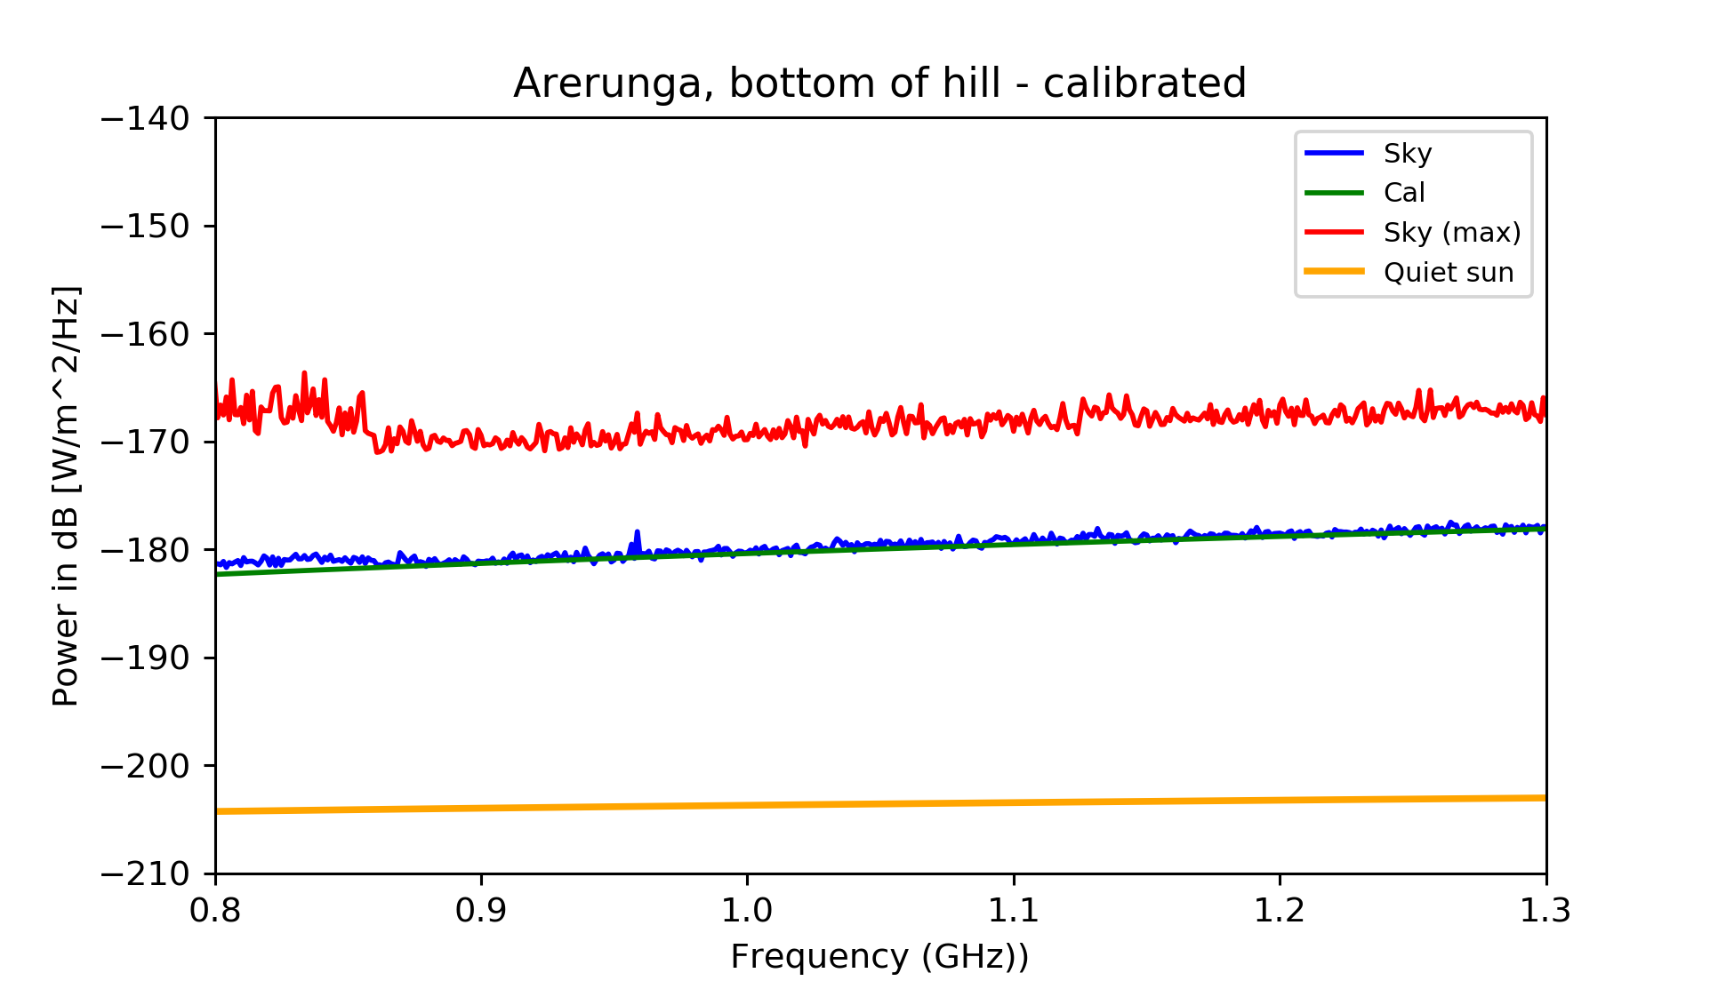
Uruguay

Slide 24
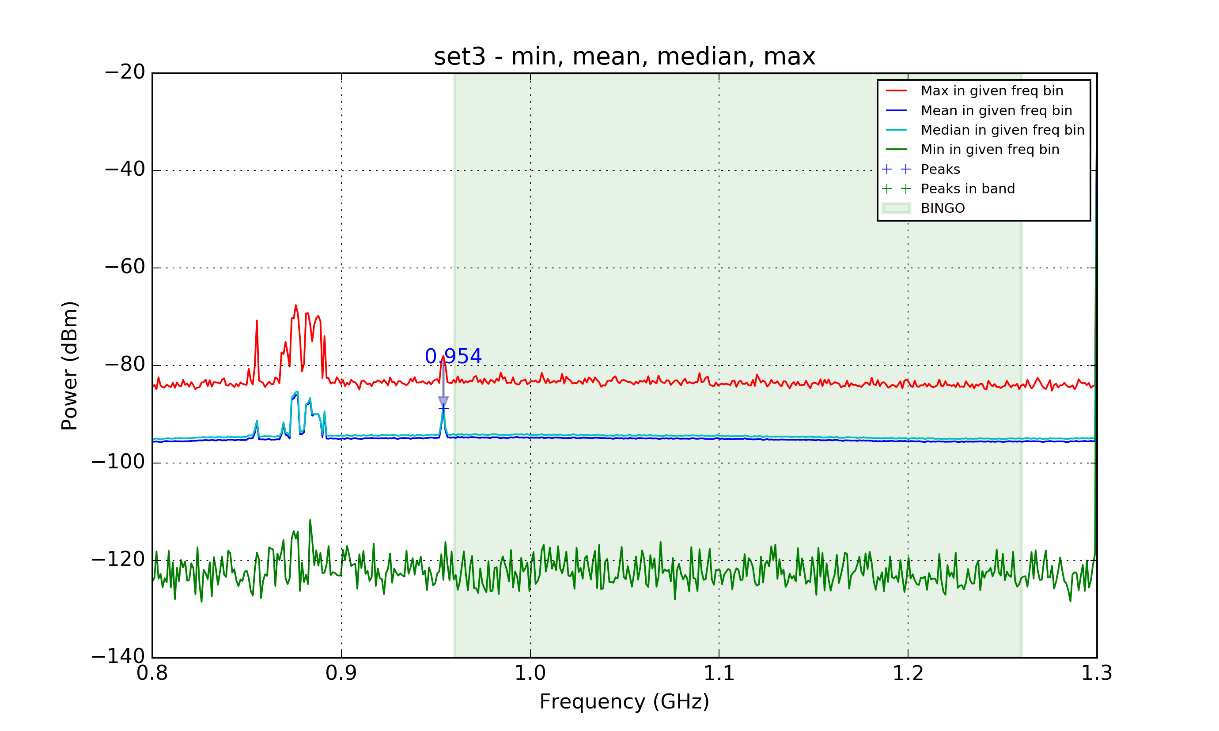
Cachoeira Paulista (SP)

Slide 25
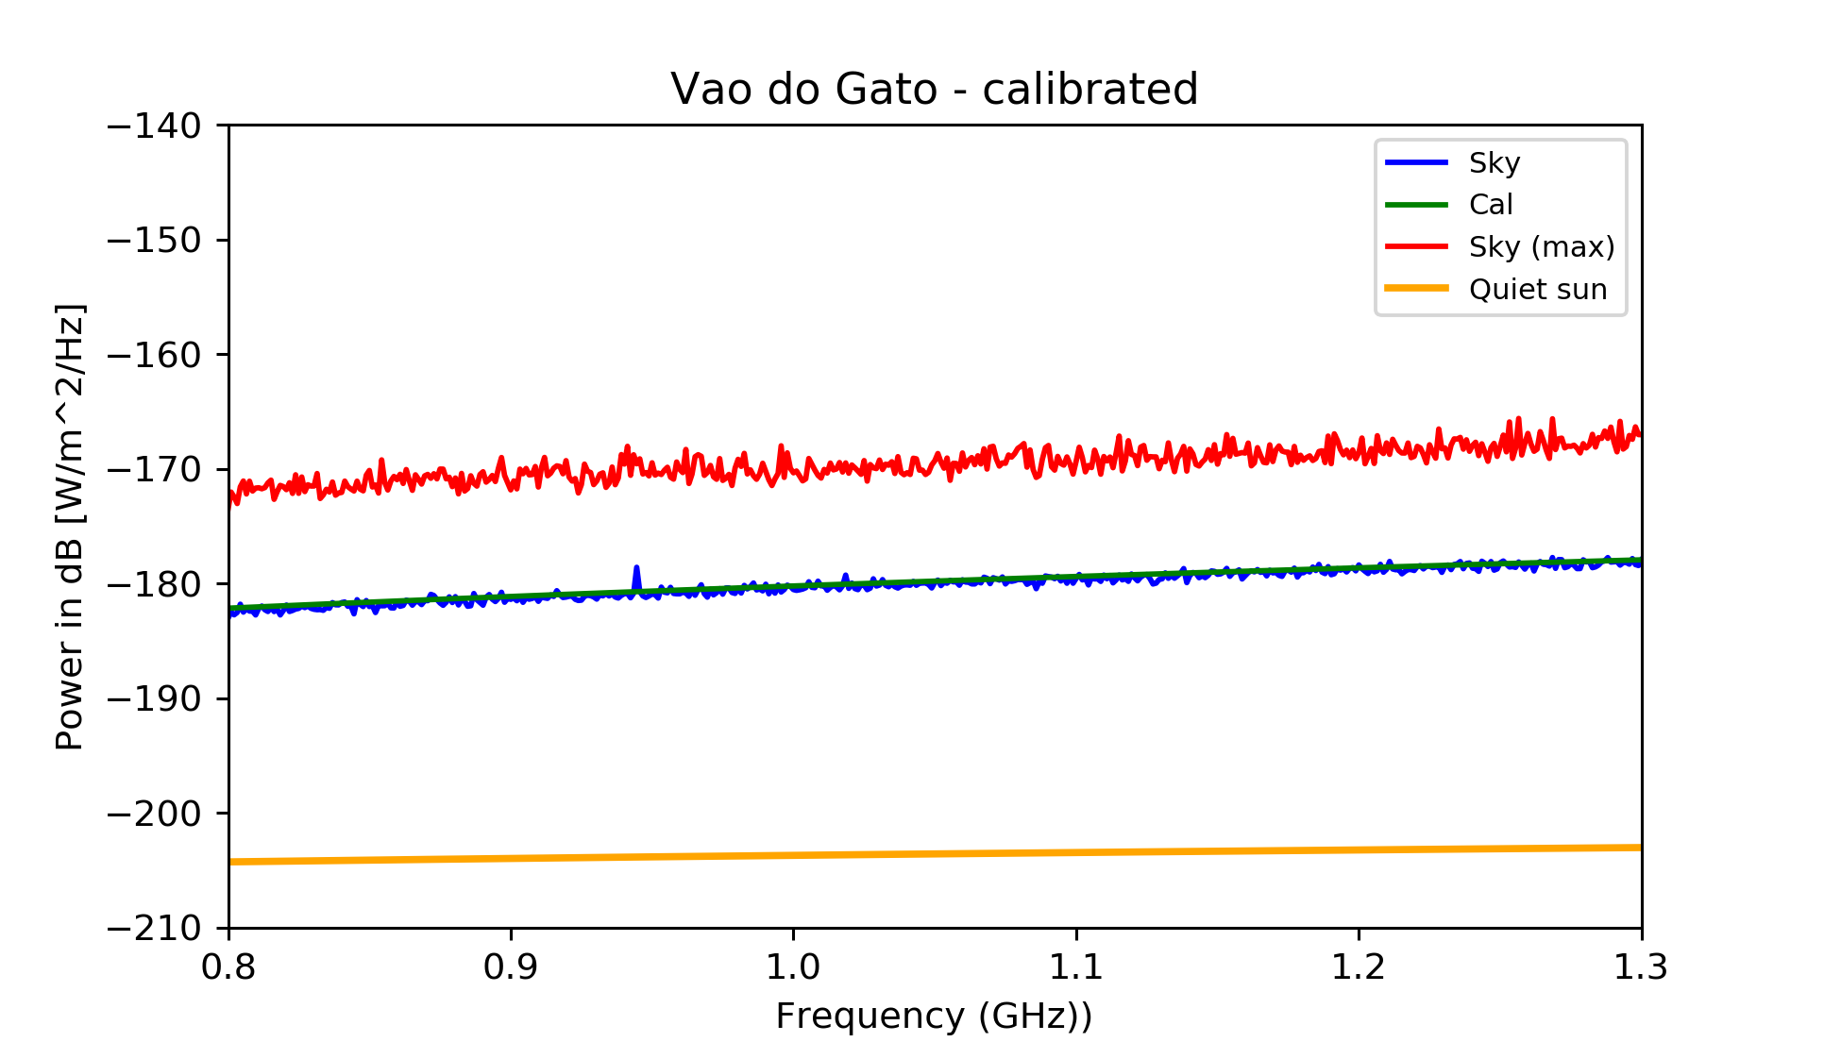
Vão do Gato (Cat’s den) Paraíba

Slide 26
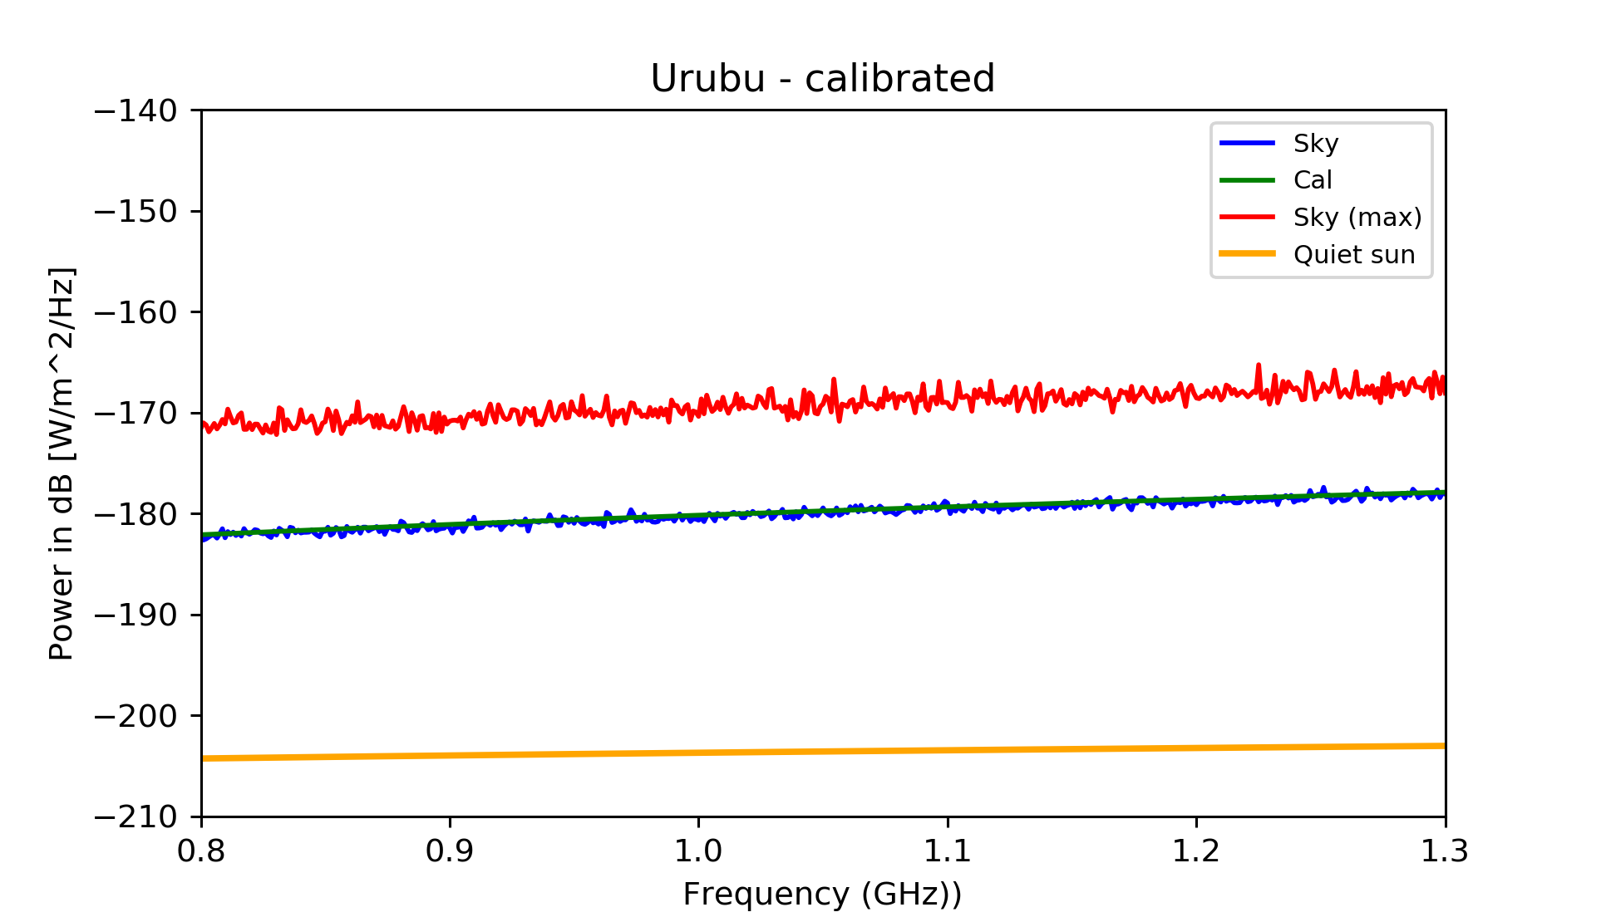
Urubu (Vulture), Paraíba

Slide 27
Motivations for BINGO
HI intensity mapping to measure BAO
Structure formation
Dark Sector properties (last half history of the Universe)
Static telescope, excellent for looking after transient phenomena
Fast astrophysical phenomena:
Pulsar properties
Fast Radio Bursts

Slide 28
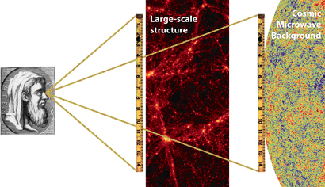
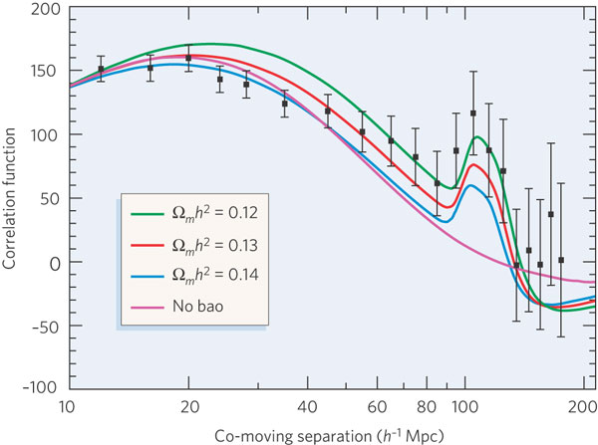
Baryon Acoustic Oscillations (BAOs)
Baryon oscillations seen in the CMB distribution can be observed in the spatial distribution of galaxies
Credit: EUCLID website (ESA)
The acoustic peak gives the ratio of the distances to z=.35 and z=1,100 to 4% fractional accuracy.
absolute distance to z=0.35 is determined to 5% accuracy.
co-moving sound horizon scale 150 h⁻¹ Mpc.
Credit: Bennett, Nature (2006)

Slide 29
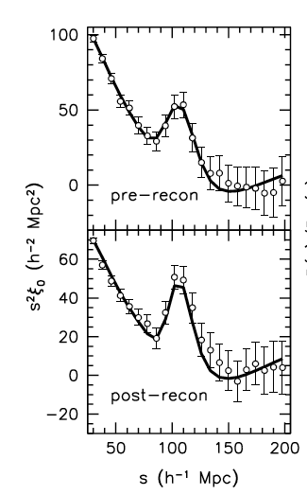
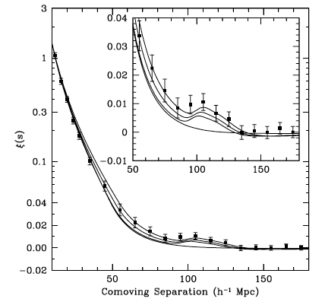
Optical BAOs
Anderson et al. (2014)
Eisenstein et al. (2005)
C.A. Wuensche (2016)
Notes:
The statistical sensitivity of the BAO measurement is limited by non-linear structure formation. Following Eisenstein et al. (2007a) we apply a procedure to reconstruct the linear density field. This procedure attempts to partially reverse the effects of non-linear growth of structure and large-scale peculiar velocities from the data. This is accomplished using the measured galaxy density field and Lagrangian theory relations between density and displacement. Reconstruction reduces the anisotropy in the clustering, reverses the smoothing of the BAO feature due to second-order effects, and significantly reduces the expected bias in the BAO distance scale that arises from these same second-order effects. Reconstruction thus improves the precision of our BAO scale measurements while simplifying our analyses.

Slide 30
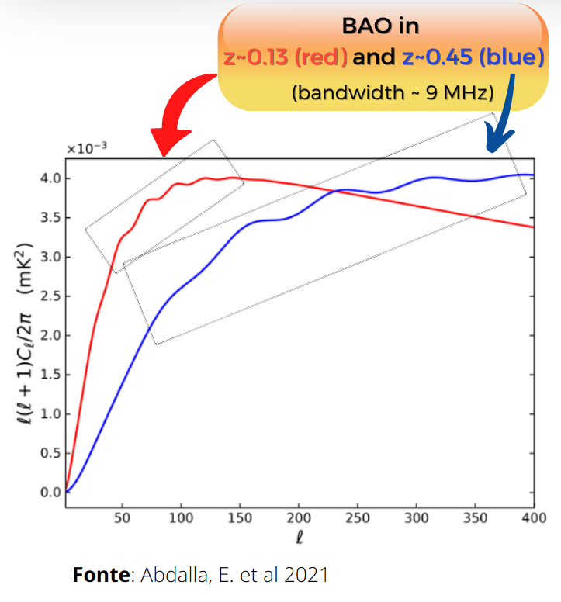
Baryon Acoustic Oscillations (BAOs)
Acoustic waves imprinted on CMB 380,000 years after Big Bang
Acoustic scale set by distance light travelled at that time
Known precisely from CMB power spectrum
D=149 ± 0.6 Mpc
BAO scale imprinted on all matter in the Universe
Use as a “standard ruler”
Credit: Chris Blake

Slide 31
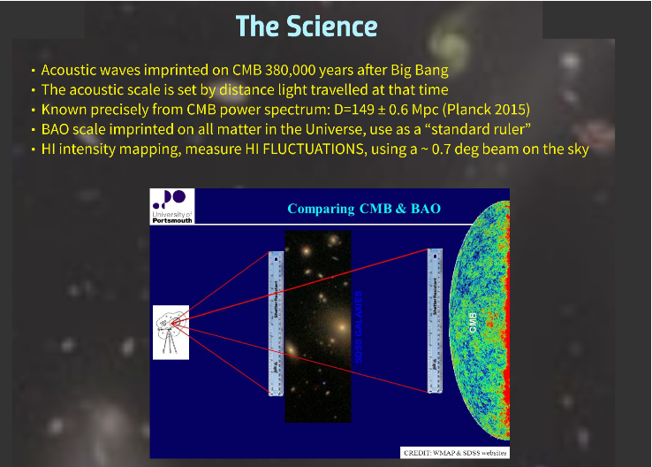

Slide 32
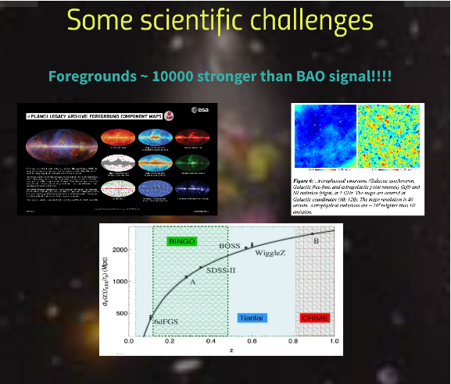

Slide 33
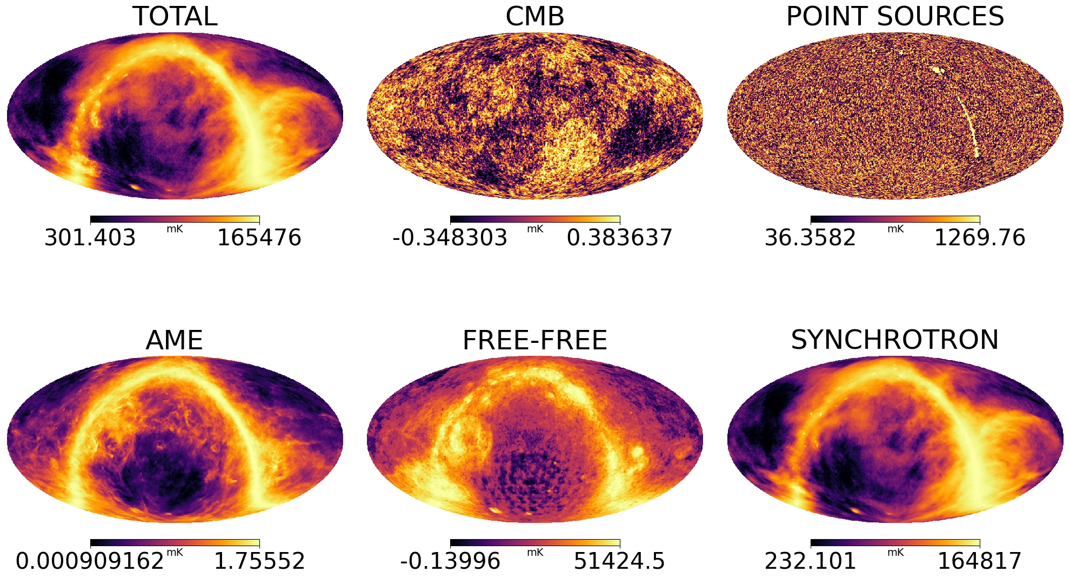

Slide 34
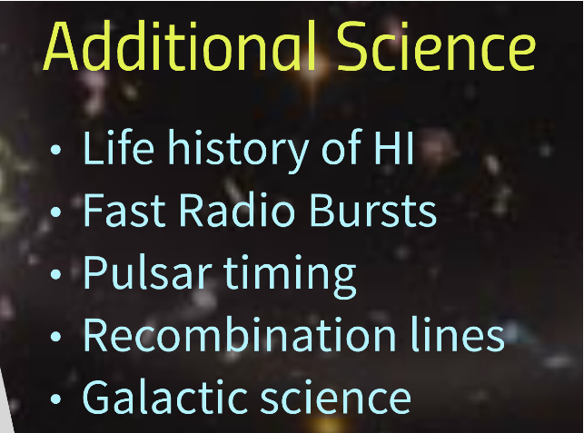

Slide 35
The various stages

Slide 36
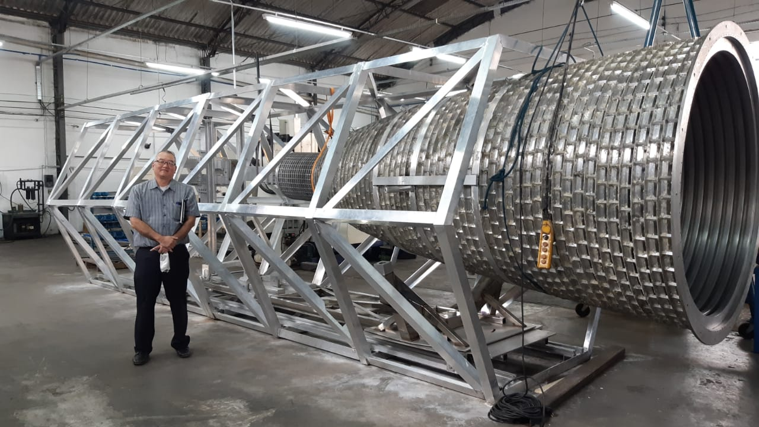
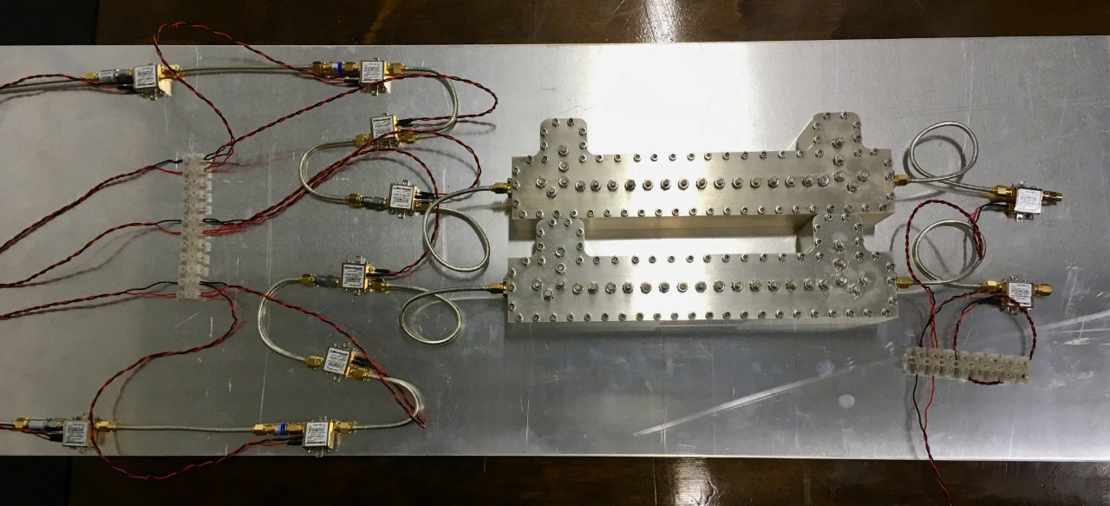
Stage 0
The Instrument:
Horns (basically done)
Receiver (already projected, now in series)

Slide 37
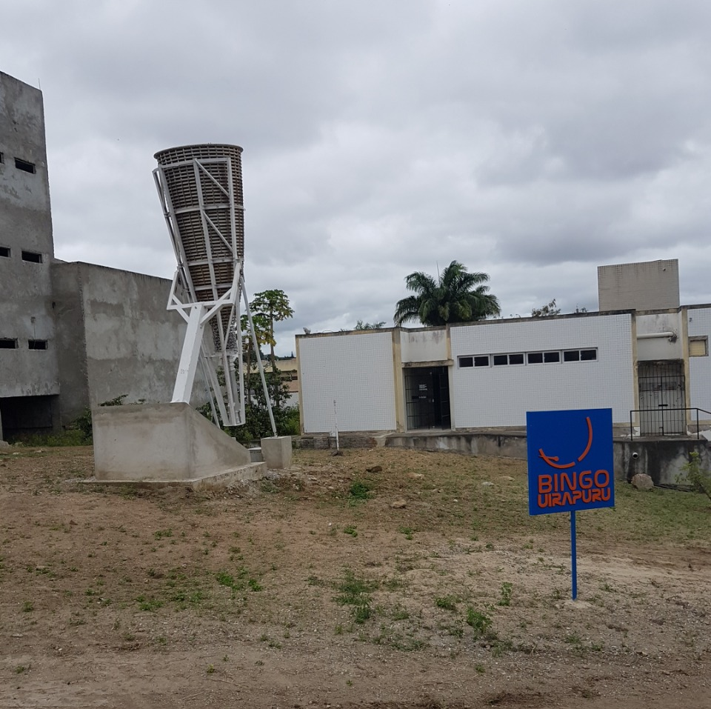
Stage 1
Raw data
FRB´s
Outriggers (Uiapuru in Campina Grande University campus, Paraiba)

Slide 38
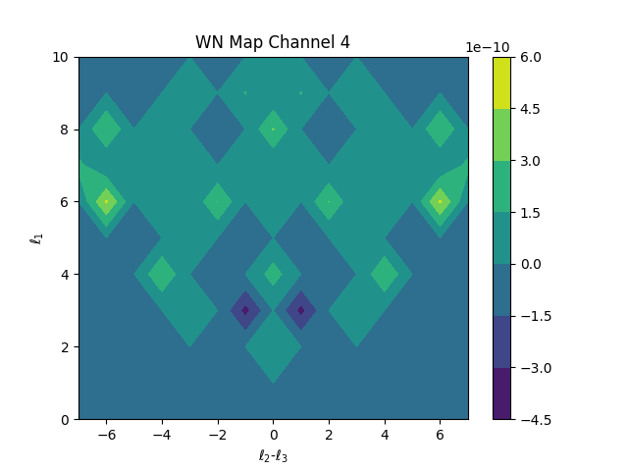
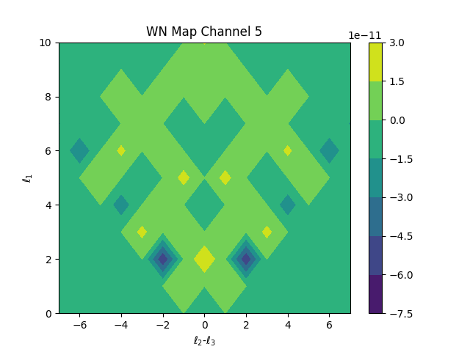
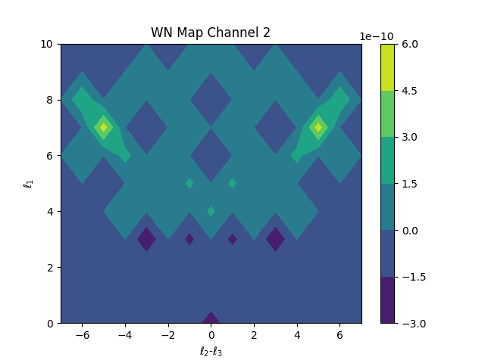
Stage 2
Component Separation
Bispectrum

Slide 39
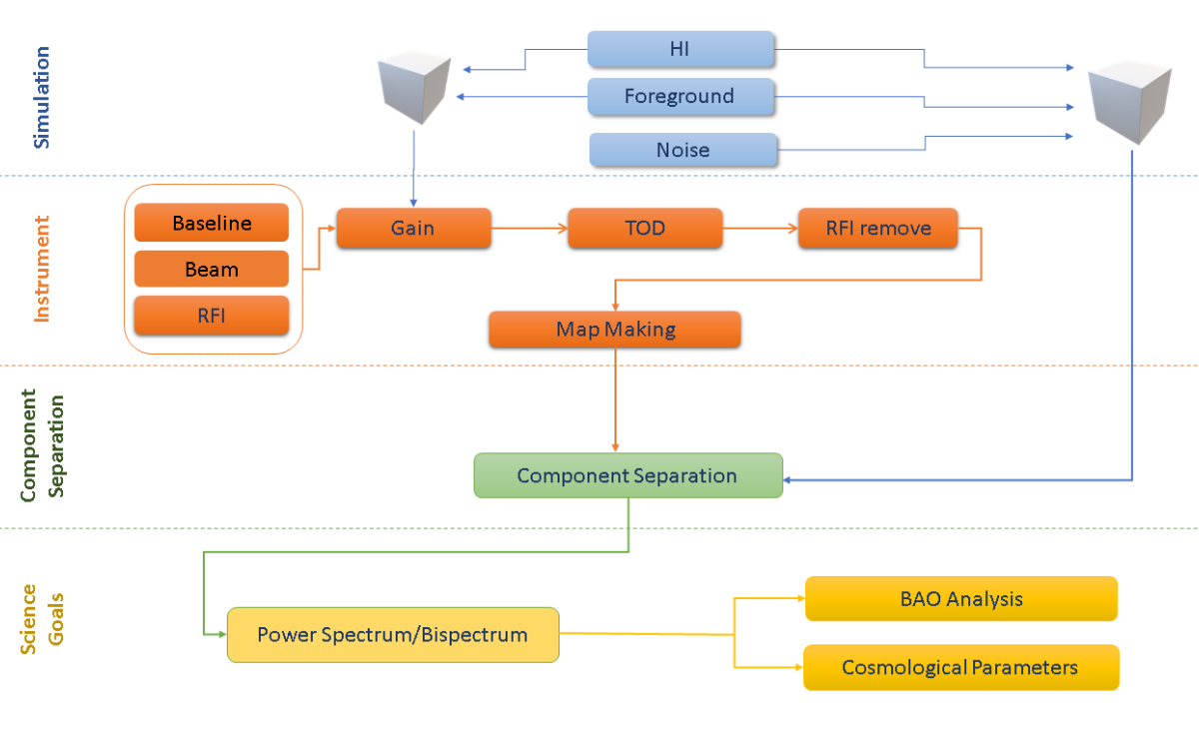
Stage 2
Component Separation: power spectrum, BAO, Cosmological Parameters

Slide 40
Stage 3
Mocks

Slide 41
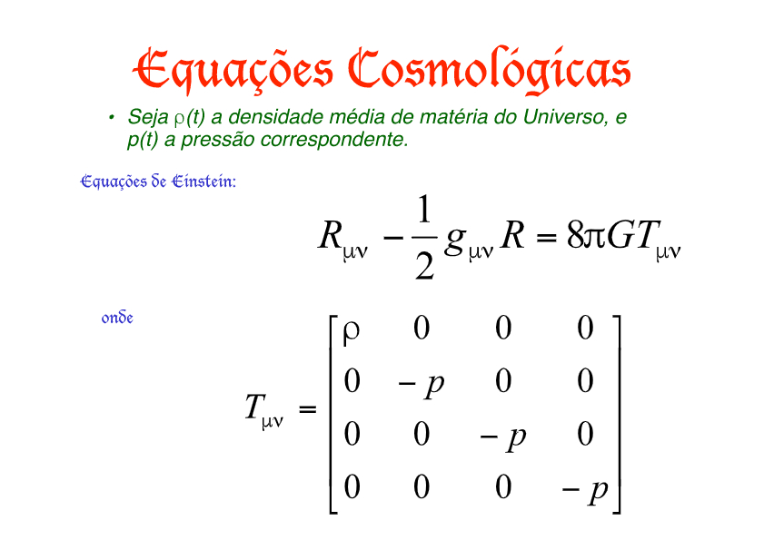
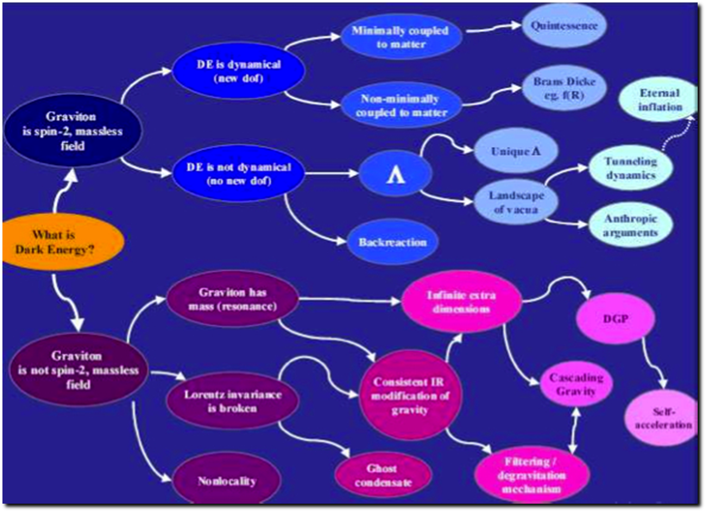
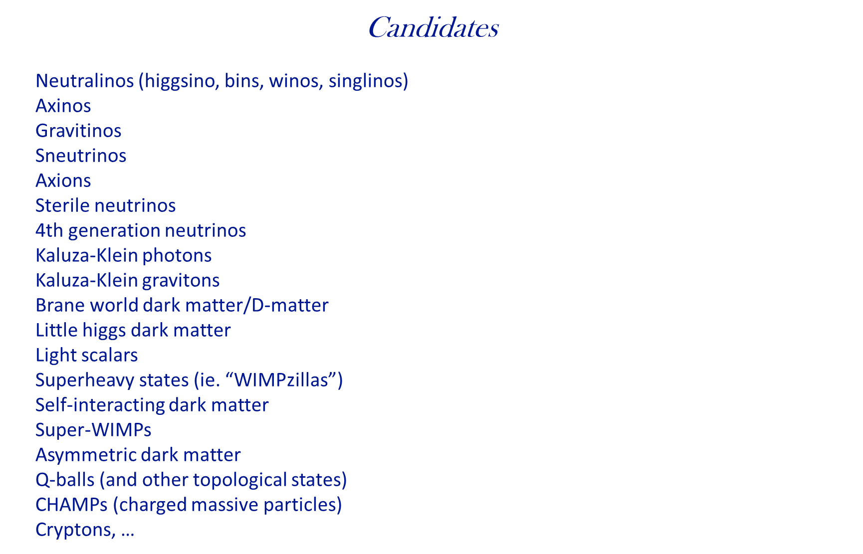
Stage 4
Theory

Slide 42
Theory
Structure of Dark Sector
cosmological parameters
DE/DM interactions
Models of DM/DE
FRB´s and cosmological parameters/consequences
Mass distribution
Pulsars
Flaring stars
Astrophysical signs and consequences
..............................

Slide 43
Why BAO in radio and in total intensity?
Complementary to optical data, different systematics
Decay time of HI hyperfine transition is ~ 10^15 seconds, but, 75% of visible matter in the Universe is made of H…
Efficient alternative for measuring a large number of galaxies individually (plus integrating the signal “alla” CMB allows for the reuse of a vast experiment in instrumentation and data analysis)
Interferometers are excellent instruments for these measurements, but are expensive and hard to operate and mantain
Single-dish instruments have been used recently, but with no positive results (although one should wait for CHIME and FAST)
Approach: single-dish, many horns X single horn per dish
E.Abdalla et all Astronomy & Astrophysics 2022, The Bingo Project I

Slide 44
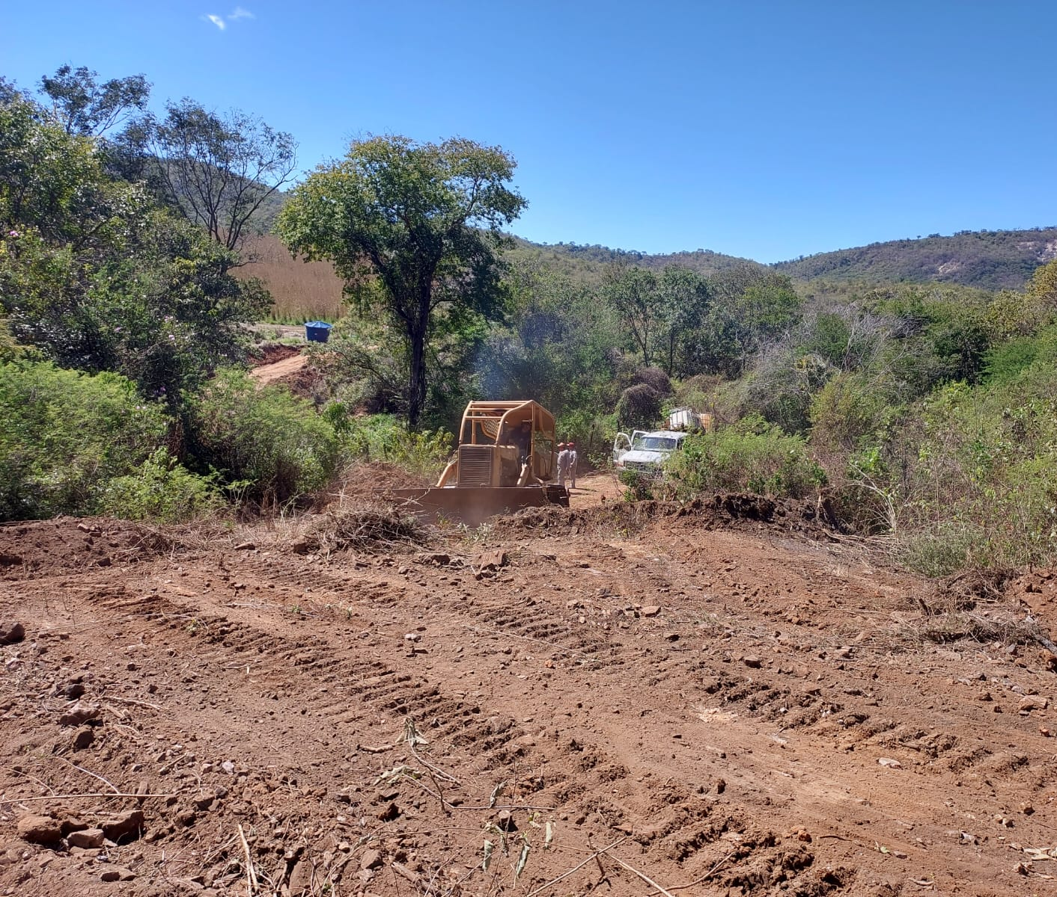
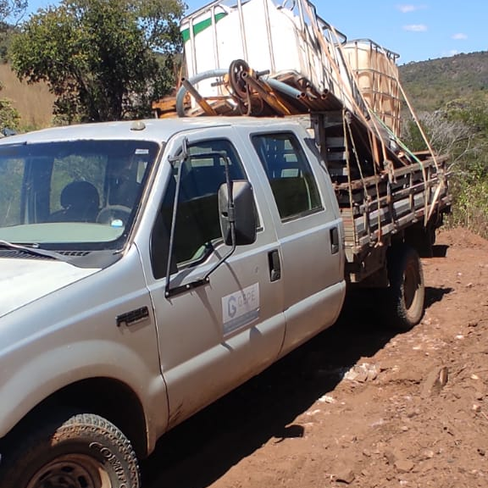


Construction
Ongoing construction operations

Slide 45



Outreach and education

Slide 46

Outreach and education
Work with local population and support from local Secretary of education from the Paraiba State

Slide 47
Talk outline
Relevance Cosmology and GR
The BINGO telescope and how to extend it.
Science possible with BINGO and HR
Cosmology extensions
FRB searches
Current status

Slide 48


Slide 49


Large Telescopes -> new discoveries
Fast Radio Bursts:
New objects, little is known and no mechanism exists to explain their nature.
Repeaters and non repeaters. One repeater in our own galaxy.
Are abundant, ~100 known up to CHIMES.
CHIMES released a catalogue of 536 FRBs, several repeaters (18)
Little is known of their localization.

Slide 50


What can we learn from FRBs?
Measure the distances
Measure the intergalactic DM
Measure turbulence in IGM
Probe missing baryons and DE
Measure the intergalactic B-field
Probe population at different redshift
Probe models that could explain population.

Slide 51

Extragalactic source possibilities
Collapsing neutron stars
Evaporating black holes
Coalescing neutron stars
Coalescing white dwarfs
Magnetar flares (FRB 200428 -> SGR 1935+2154)
Supernovae
Giant pulses
Cosmic strings...
FRB 20191221A -> muiti pulse FRB 9 pulses separated by 200ms.
Some of the above postulated in our group

Slide 52







BINGO High Resolution: The abdus project
(Filipe Abdalla)
450 – 1450 MHz
(z ~ 0 – 2.1)
1 MHz resolution
1.2 deg Resolution
T system 40K
Station 4500 m²
- What is the nature of dark energy?
- Can we measure the fluctuations with 21cm radiation
- Is our model of cosmology correct?

Slide 53





Mapping DE and finding FRBs
Use proven technology with a standard 2 dish telescope.
The first one to measure the primordial baryon fluctuations of HI imprinted onto the sky.
Measure the DE and test Einstein's theory of relativity.
Bingo HR will increase resolution, range and sensitivity!
Phased array feeds: ‘see’ the entire sky at the same time

Slide 54

abdus forecasts
Can be competitive with even the largest surveys such as the Square Kilometre array.
Can also do other ancillary science extremely well such as finding the elusive FRBs.

Slide 55


Back to BINGOHR: BAO “Hubble diagram”

Slide 56








BINGO BAOs from Integrated Neutral Gas Observations
Abdus: Advanced Bingo Dark Universe Studies Mainly Brazil and China collaboration

Slide 57



Slide 58
Support
FAPESP (Fundação de Amparo à Pesquisa do Estado de São Paulo)
Paraiba government
FINEP (Projects and Studies financing – Federal Government)
Ministry of Science and Tecnology (Brazil)
National Natural Science Foundation of China
YangZhou University (China)
INPE (National Institute of Space Research, Brazil)
University of São Paulo
Federal University of Campina Grande

Slide 59




Main Collaborating Companies
Alltec (São Paulo): metallurgy/horns
CETC 54 (China): metal structure
IBRTEL (Paraiba): construction
Ponto de Apoio and GTP (projects)

Slide 60




Main Collaborating Companies
Alltec (São Paulo): metallurgy/horns
CETC 54 (China): metal structure
IBRTEL (Paraiba): construction
Ponto de Apoio and GTP (projects)

Slide 61


The ABDUS extension: 21 cm Cosmology and FRB Science

Slide 62
Back to BINGO: BAO “Hubble diagram”
ABDUS

Slide 63
The Three Eyes of the Universe
Bingo/Abdus
TianLai
Fast

Slide 64
The Three Eyes of the Universe
Collaboration activities
Common spots of the Universe
Cosmological expectations concerning FRB´s (not the same, but adding observations)
Still FRB´s: multiple obsertations of repeaters?
Constraining further the cosmological parameters: beating SKA?

Slide 65
Mapping DE and finding FRBs
Use proven technology with a standard 2 dish telescope.
The first one to measure the primordial baryon fluctuations of HI imprinted onto the sky.
Measure the DE and test Einstein's theory of relativity.
Bingo HR will increase resolution, range and sensitivity!
Phased array feeds: ‘see’ the entire sky at the same time

Slide 66

Using phased arrays for Cosmology and FRB searches.
Three arrangements considered:
A - New detectors as outriggers, to locate FRBs -> 3 * 6m stations.
B – New detectors at the focal plane of the instrument
C – New detectors as phased arrays in the ground. 40m diameter stations
SKA technology not selected.

Slide 67
Using phased arrays for Cosmology and FRB searches.
Three arrangements considered:
A - New detectors as outriggers, to locate FRBs -> 3 * 6m stations.
B – New detectors at the focal plane of the instrument
C – New detectors as phased arrays in the ground. 40m diameter stations
SKA technology not selected.

Slide 68
Questions concerning the three projects
Can Abdus, TianLai and Fast have similar observations?
Can they compare?
Cosmology with FRB´s is the most obvious step
Probability Density Functions are also “additive”
Observation of the South Sky may suplement common understanding
Better understanding of the Milky Way Structure and nearby matter distribution.

